Slide 1
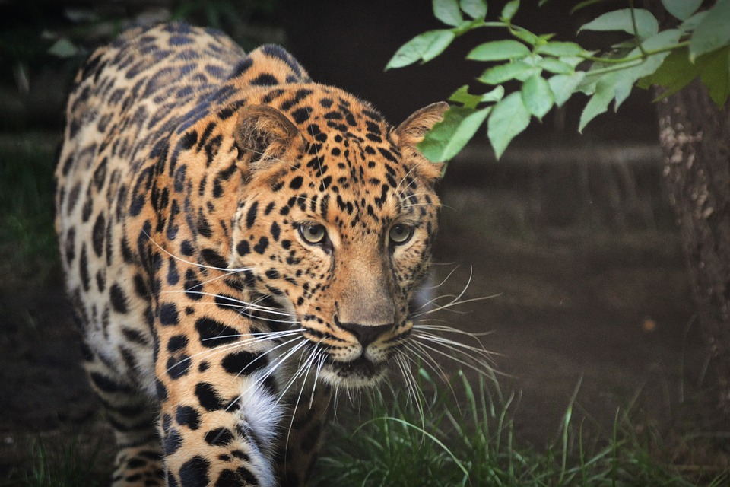
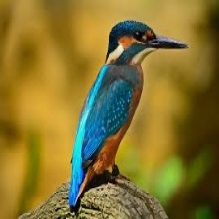

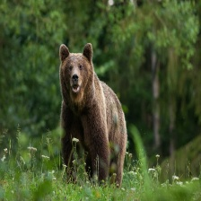
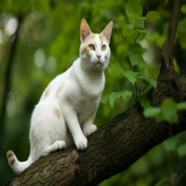
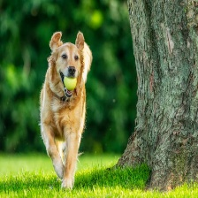
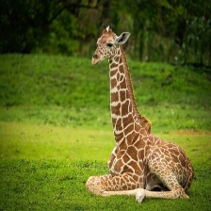
Animal Classifier Using Deep Learning & Transfer Learning.
Presented by – Aritra Mukherjee
ID: UMIP270247
Machine Learning Intern
At - Unified Mentor Pvt. Limited
Aritra Mukherjee

Slide 2
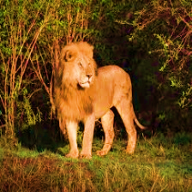
Introduction To Project –
Animal Classification
Animal classification is an essential task in the field of computer vision, where the goal is to identify the category of an animal based on an input image. This project focuses on building an intelligent system that can automatically classify animals into 15 predefined categories using image data.
By training a model on a diverse dataset of animal images, we aim to develop a solution that understands visual patterns and features—such as shapes, colors, and textures—to accurately predict the animal shown in the image.
This project not only helps in applying core deep learning concepts but also demonstrates how AI can be used in real-world scenarios such as wildlife conservation, educational tools, and image-based search systems.
Aritra Mukherjee

Slide 3
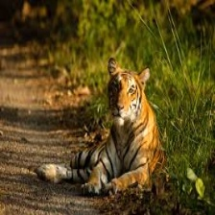

GOAL
In this project, our goal is to develop an intelligent image classification system capable of recognizing different animals from input images.
My aim to create a solution that can:
Automatically analyze an image and identify the animal shown.
Provide accurate predictions in real time
Offer a smooth and interactive user experience for classification
Aritra Mukherjee

Slide 4
Dataset Overview for Classification
Dataset Structure
The dataset comprises 15 folders, each representing a distinct class for classification tasks.
Image Dimensions
All images in the dataset are standardized to dimensions of 224 x 224 x 3 pixels, ideal for deep learning applications.
Suitability for Deep Learning
The dataset is specifically designed for image classification using deep learning and transfer learning methods.
Class Representation
Each folder's name corresponds to a specific class label, facilitating organized data handling.
Image Classification Potential
This dataset provides a robust foundation for training models on various animal classifications.
Aritra Mukherjee

Slide 5
Animal Classes in the Dataset
1
Bear
7
Dolphin
Elephant
Giraffe
Horse
Kangaroo
Panda
2
Dog
8
3
Cat
13
Tiger
Zebra
9
4
Cow
14
10
15
Lion
5
Deer
11
12
6
Bird
Aritra Mukherjee

Slide 6
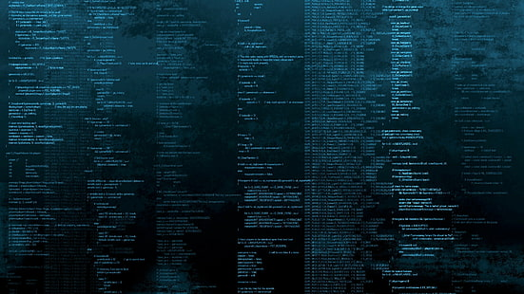
Tech Stack
Technologies & Tools Used
🔸 Python The primary programming language used for data handling, model training, and app logic.
🔸 TensorFlow & Keras Deep learning libraries used to build and train the convolutional neural network (CNN) model.
🔸 Transfer Learning (MobileNetV2) A lightweight, pretrained model used to enhance performance and reduce training time.
🔸 Gradio A user-friendly library to create an interactive web interface for real-time predictions.
🔸 Hugging Face Spaces Used for deploying the model and app to the web, making it publicly accessible without requiring backend infrastructure.
Aritra Mukherjee

Slide 7
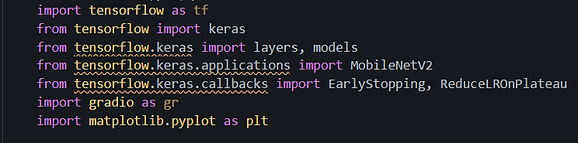
Import Required Libraries
Aritra Mukherjee

Slide 8
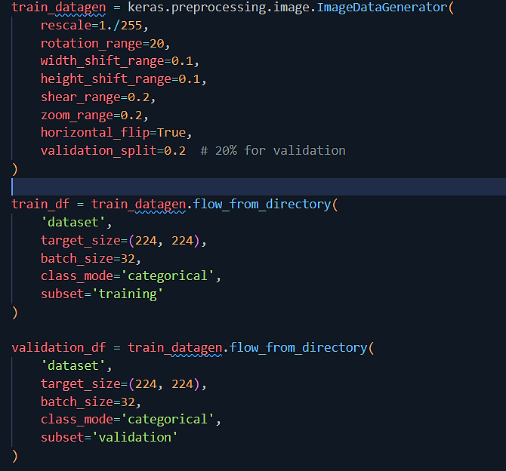

Prepare the Data with Augmentation
Aritra Mukherjee

Slide 9
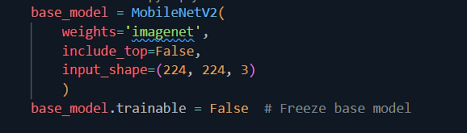
Load Pretrained MobileNetV2
Loads MobileNetV2
(pretrained on ImageNet) without the top layer and freezes it so only the new layers will train.
Aritra Mukherjee

Slide 10
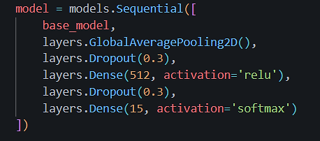
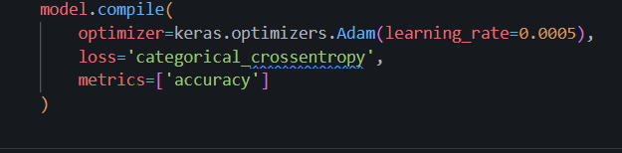
Build the Full Model
Compile the Model
Aritra Mukherjee

Slide 11
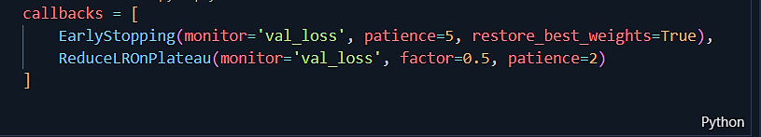
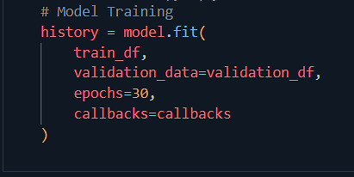
Define Training Callbacks
Train the Model
Aritra Mukherjee

Slide 12
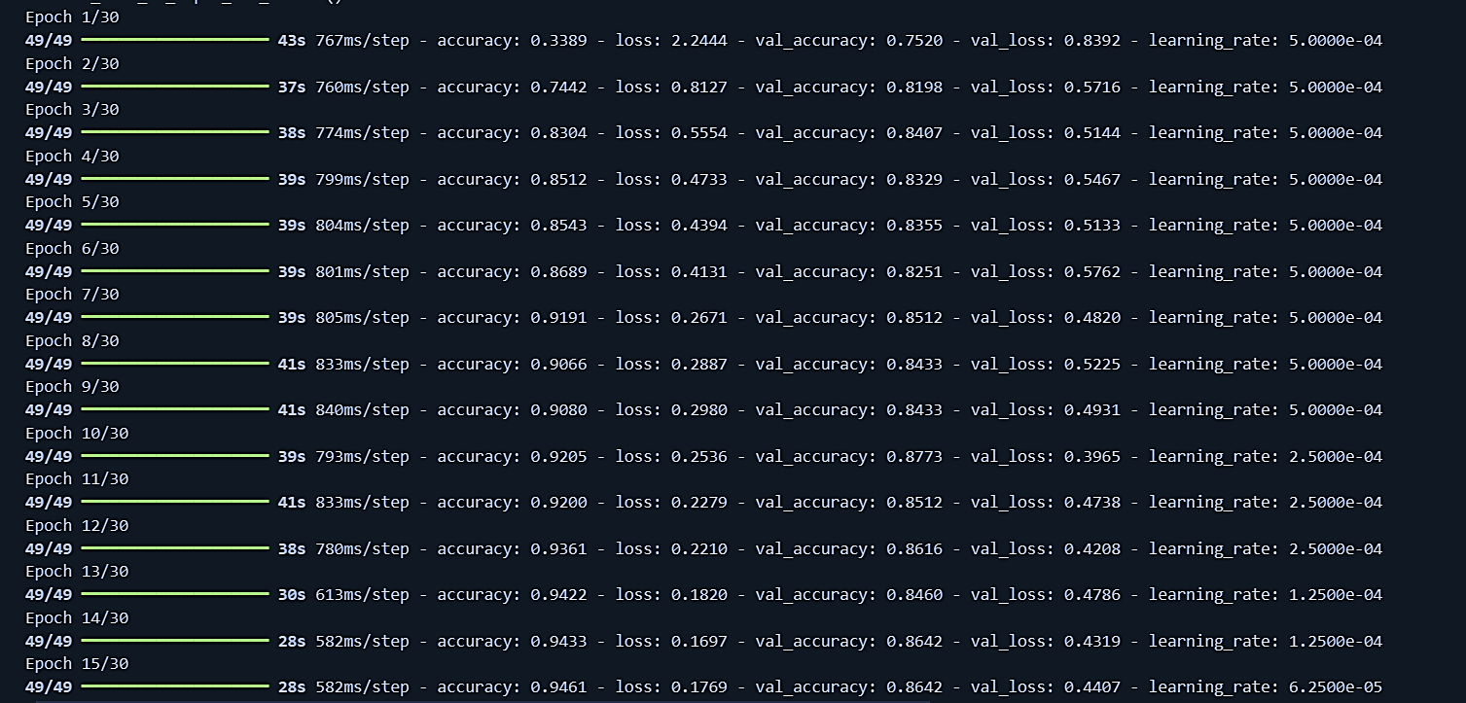
Train the Model
Accuracy – 94%
Aritra Mukherjee

Slide 13

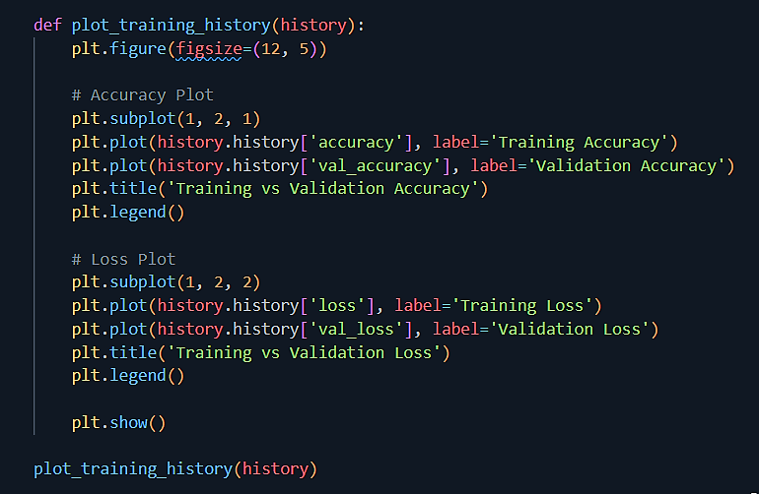
Save the Trained Model
Visualize Training History
Aritra Mukherjee

Slide 14
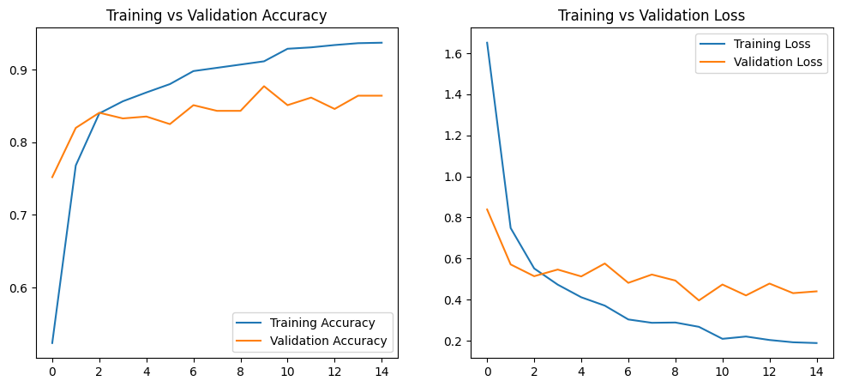
Visualization
Aritra Mukherjee

Slide 15
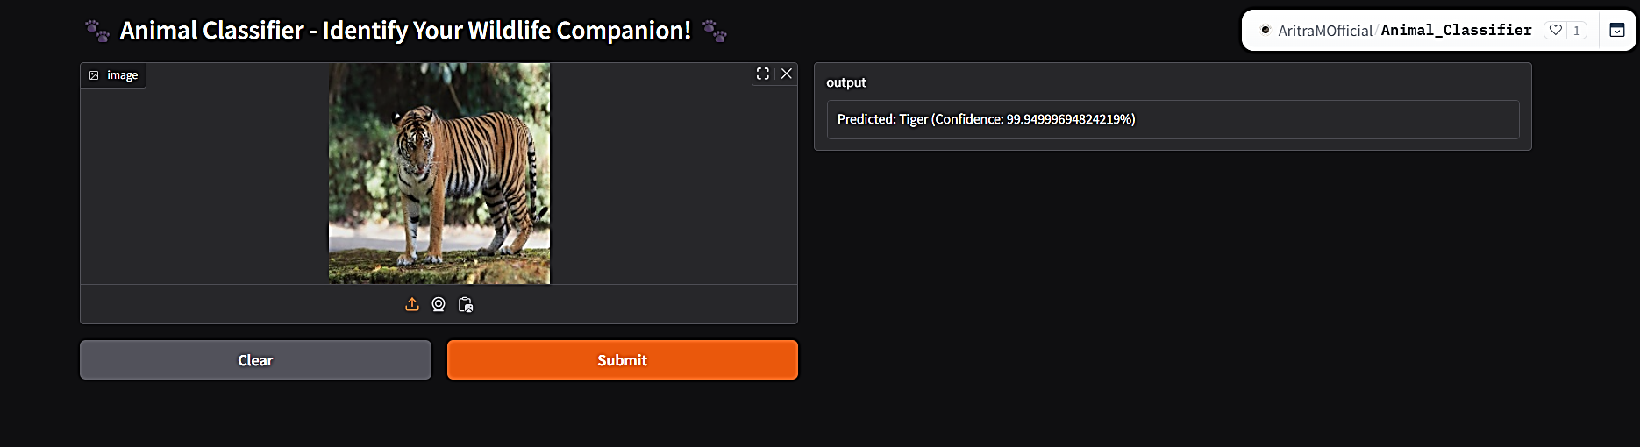
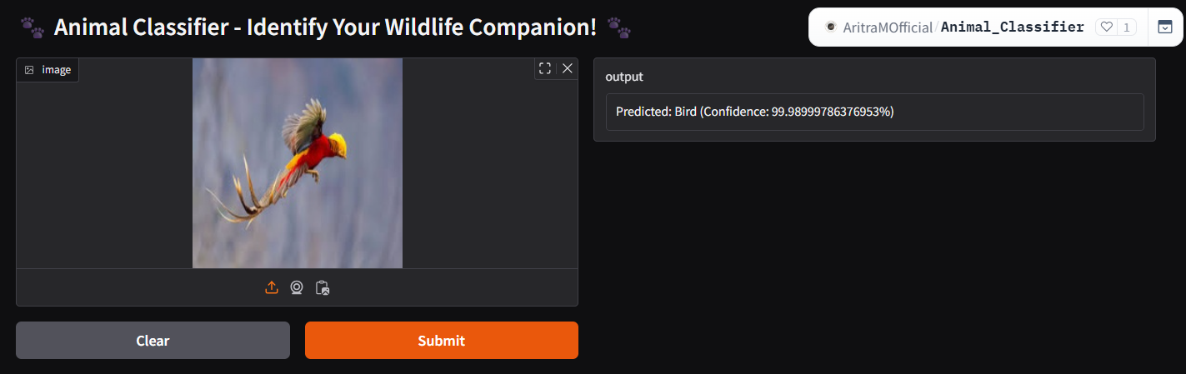
Prediction
Aritra Mukherjee

Slide 16
Deploy Using Hugging Face Space
Live Demo -
aritramofficial-animal-classifier
Aritra Mukherjee

Slide 17
Conclusion
We successfully built an intelligent animal image classifier that predicts the animal in any given image with high accuracy.
It demonstrates the practical use of deep learning in solving real-world visual problems and can be applied in areas like wildlife monitoring, educational apps, and smart animal recognition systems.
Aritra Mukherjee

